Slide 1

Acute Liver Failure
Formerly, Fulminant Hepatic Failure
Brian Locke
Notes:
The title character is ALF (an acronym for "alien life form") who crash-lands in the garage of the suburban middle-class Tanner family.
ALF was kind of an idiot. Got in trouble for drinking on the show, and also for trying to turn a bathtub into a jacuzzi using electrical appliances – near miss of a kido electrocuting themselves.

Slide 2
Acute Liver Failure
Formerly, Fulminant Hepatic Failure
Brian Locke

Slide 3
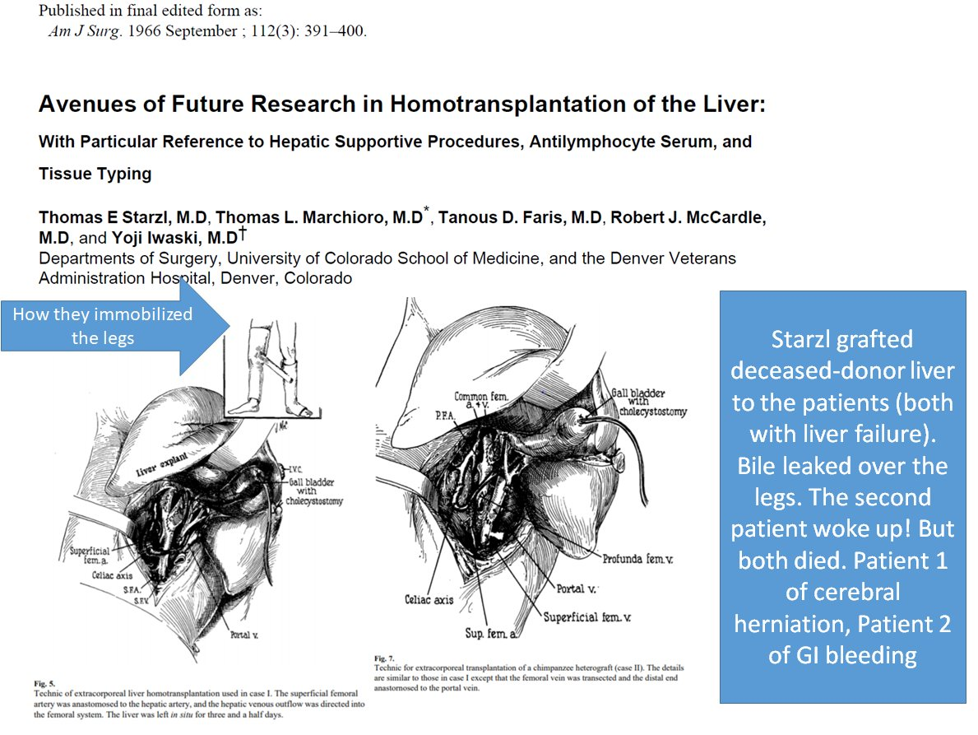
What organs don’t have temporary extracorporeal support options? Source: Elliot Trapper, U Mich Hepatology
Notes:
Liver
(Brain not really, but we can shut it off for a while by inducing coma)

Slide 4
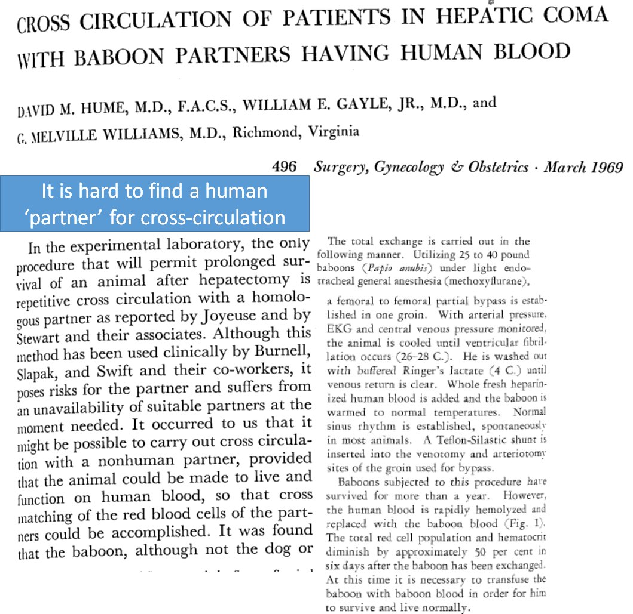
Notes:
https://www.thelancet.com/journals/lancet/article/PIIS0140-6736(68)90691-0/fulltext#articleInformation

Slide 5
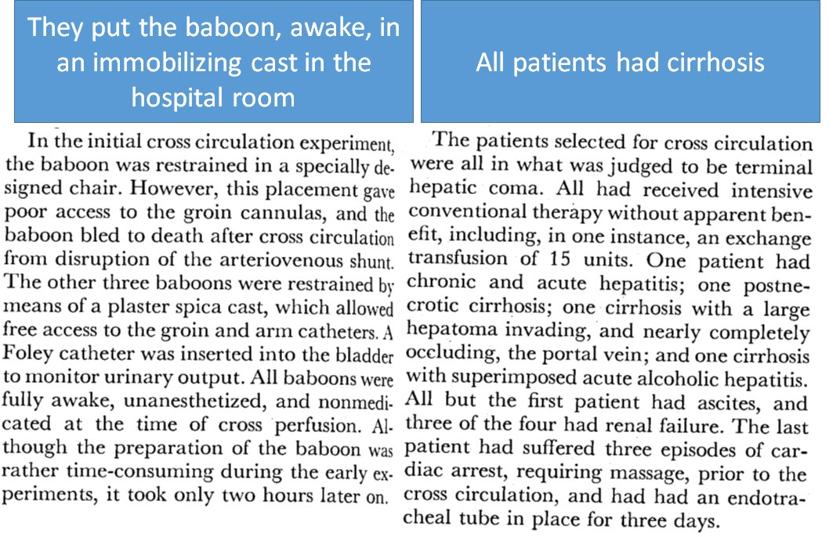

Notes:
Lactulose/Rifaxamin (for chronic), antibiotics, and most importantly, liver transplantation replaced the need for this ridiculousness
Imagine tryingto orient thepa patient to this…
Innovative technologies, such as albumin dialysis and bioartificial devices using hepatocyte cell lines or porcine hepatocyte bioreactors, have yielded poor results. Although liversupport devices might transiently improve biochemical indices of liver function, none has been shown to reliably bridge patients with acute liver failure to recovery with their native or a transplanted liver.73
In a multicentre, randomised study of standard medical treatment versus standard treatment plus high-volume plasma exchange,74 survival to hospital discharge stratified for liver transplantation was higher in patients who received high-volume plasma exchange. Thus, this treatment might be more readily available and better substantiated than other liver-support devices, but further study is required

Slide 6
Roadmap – Acute Liver Failure
Definition
Workup
Complications
Treatment
Prognostication

Slide 7
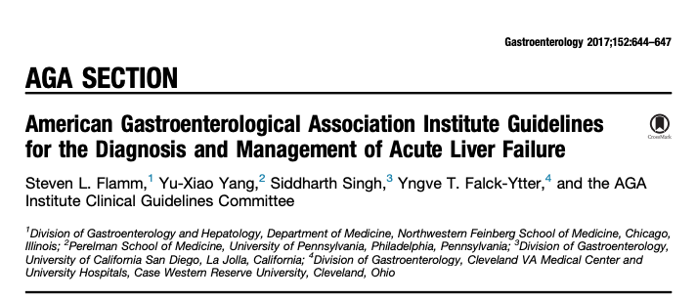
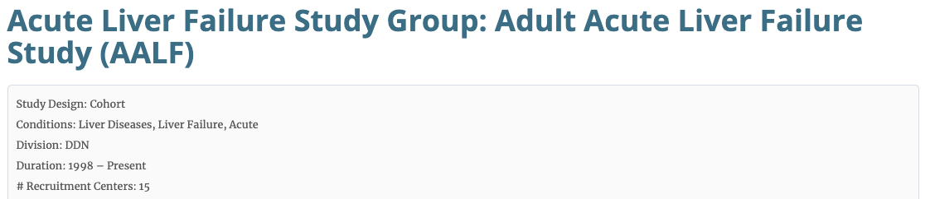
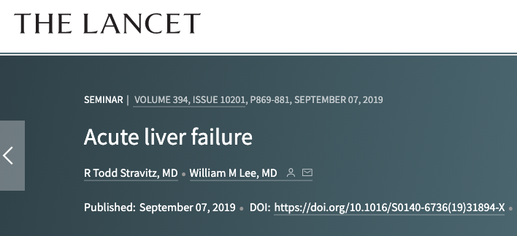
**contrast to 2011 AASLD Acute Liver Failure Guideline

Slide 8
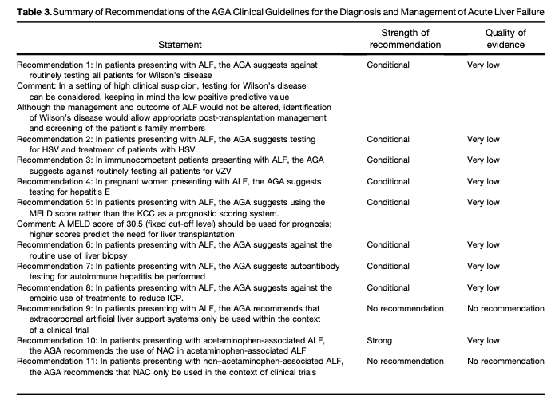

Slide 9
Case
55F with a history of T1DM presents due to jaundice.
She has no history of liver disease.
Drinks occasionally. BMI 27.
On exam, she is lucid. No sleep disturbance reported
AST/ALT 3k. INR 2.1. Alk phos 200, Bili 15
US not suggestive of cirrhosis
Is this acute liver failure?

Slide 10
Definition
How do you differentiate acute liver failure from severe hepatitis?
-Bilirubin?
-Synthetic Dysfunction?
-Degree of AST/ALT?
-HE?
-Presence of decompensation event? (Variceal Bleed, HRS, Ascites, HE)

Slide 11
Definition – Acute Liver Failure
Acute (<26 weeks), no pre-existing liver disease
mirkier if disease was likely present, but not diagnosed (HBV, Wilsons, Autoimmune)
Typically, not called ALF in the case of acute on chronic EtOH
Hepatic Encephalopathy
Liver synthetic dysfunction (e.g., INR 1.5+)
Vs Severe Liver Injury aka Severe Hepatitis:
AST/ALT > 10x ULN +/- synthetic dysfunction
Note: can have liver synthetic dysfunction in severe hepatitis
Notes:
Three causes of acute liver failure can present as a fulminating acute decompensation of chronic liver disease, and might still be considered cases of acute liver failure: Wilson disease, reactivation of chronic hepatitis B infection, and autoimmunity.
“ACUTE” – 26 weeks. – a long acute

Slide 12
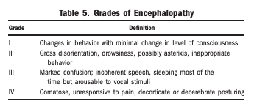
Why define based on HE?
Very different prognosis
Pre-transplant mortality: 80%
Now, 33%, and 25% get transplanted (difference attributed primarily to better supportive care)
Spontaneous recovery is more likely with lower grades of encephalopathy
Grade I to II – 65 to 70 percent
Grade III – 40 to 50 percent
Grade IV – <20 percent
Notes:
[ ] ref 71 in uptodate

Slide 13
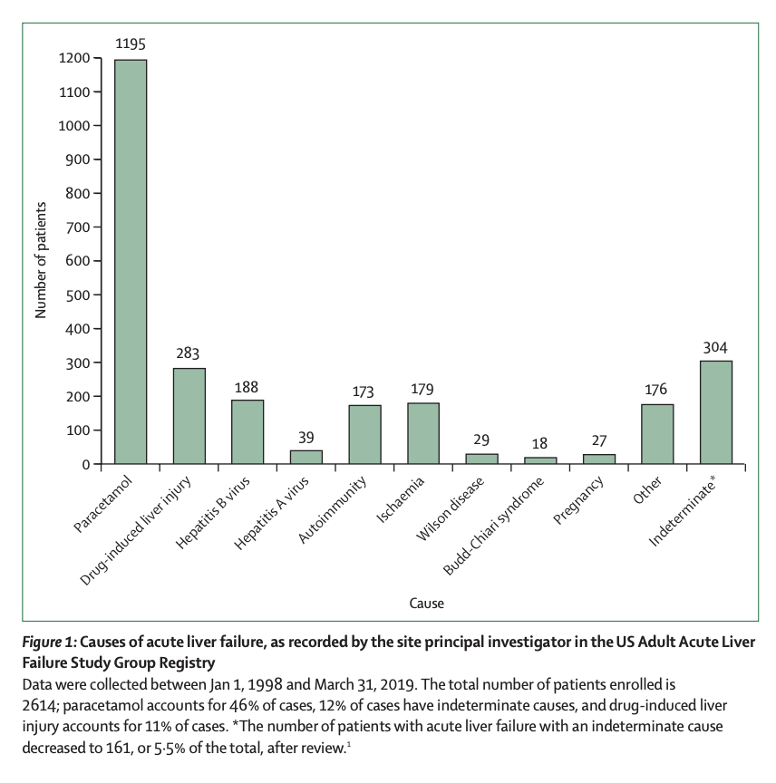
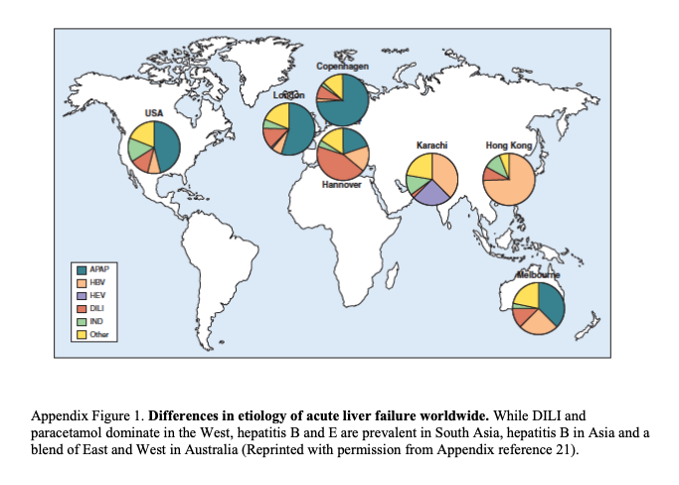
Notes:
Of note: HCV and NASH are not on here – generally do not present this way, solely as acute on chronic liver failure
Viral hepatitis most common in developing countries (A, B, E)
Amanita phalloides (and related species) mushroom poisoning, which causes acute liver failure, is rare in the USA, but occurs more frequently worldwide;

Slide 14
Not:
NASH, HCV, A1AT, PBC (anti-mito), Hemochrom.
Notes:
Viral hepatitis most common in developing countries (A, B, E). Also HSV
Amanita phalloides (and related species) mushroom poisoning, which causes acute liver failure, is rare in the USA, but occurs more frequently worldwide;’
Checkpoint inhibitor probably more common

Slide 15
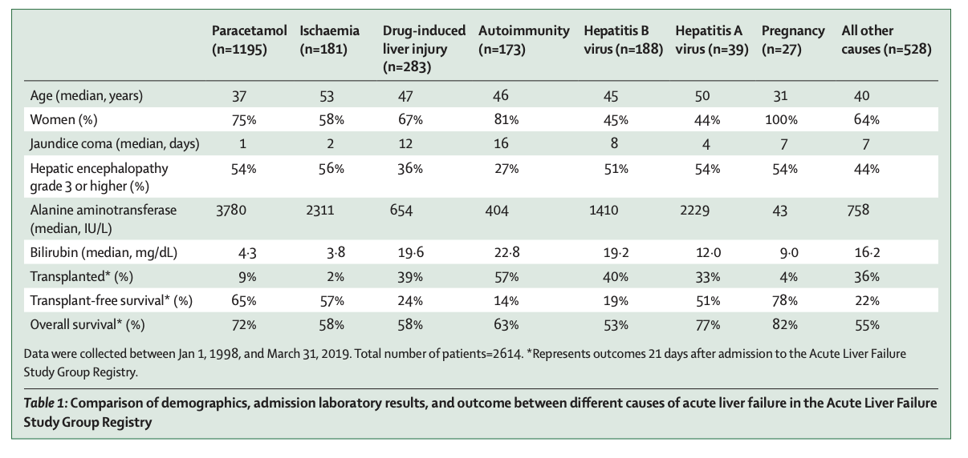
Lots of data comes from the US Adult Acute Liver Failure Study Group Registry
Notes:
Pattern gives hints:
Young all across the board
Ischemia and hepatitis are very close – hyperacute
DDx for AST/ALT over 3000 and bili less than 5.0: acetaminophen, ischemia (congestion, hypovolemia, post-arrest), heat stroke, cocaine tox
DILI and Autoimmune on the other end of the spectrum
Fulminant Hepatic Failure from Hep B usually occurs from new infection (2/3s) or new immunomodulation

Slide 16
Case
Which of the following tests should be sent?
HAV (IgM Anti HAV)
HBV (IgM Anti HBc, HBsAg, Anti HDV)
HCV (HCV Ag)
HEV (IgM Anti HEV)
HSV (IgM Anti HSV)
VSV (IgM Anti VSV)
APAP level
EtOH level / Ethyl Glucuronide
ANA, IgG level, ASMA
Ceruloplasmin
Anti mitochondrial antibody
Alpha 1 antitrypsin
Ferritin and TSAT
US with Doppler
You diagnose her with severe hepatitis and begin a workup. Over the next day or so, she becomes progressively more lethargic, slurred in her speech, and has asterixis. You diagnose HE, Grade 3 of 4 by WHC

Slide 17
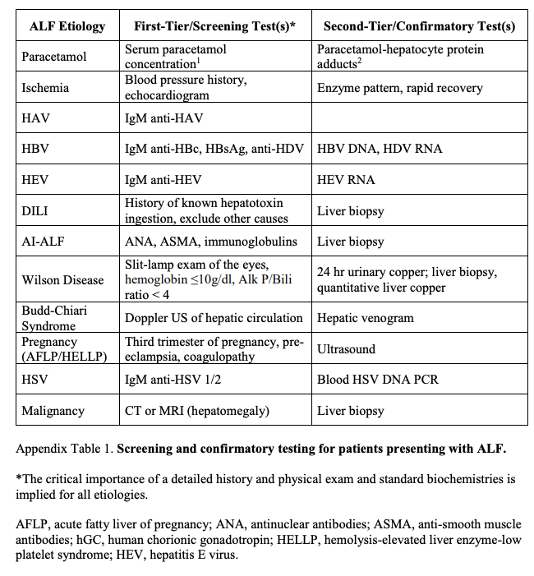
Testing strategy:
HAV (IgM Anti HAV)
HBV (IgM Anti HBc, HBsAg, Anti HDV)
HCV (HCV Ag)
HEV (IgM Anti HEV) (do if pregnant)
HSV (IgM Anti HSV, or PCR if fast)
VSV
APAP level
EtOH level / Ethyl Glucuronide
ANA, IgG level, ASMA
Ceruloplasmin
Anti mitochondrial antibody
Alpha 1 antitrypsin
Ferritin (high in all)
US with Doppler

Slide 18
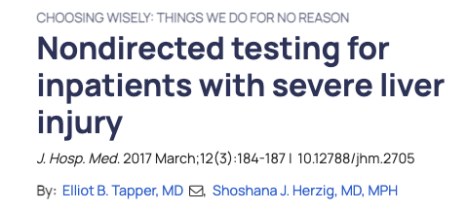
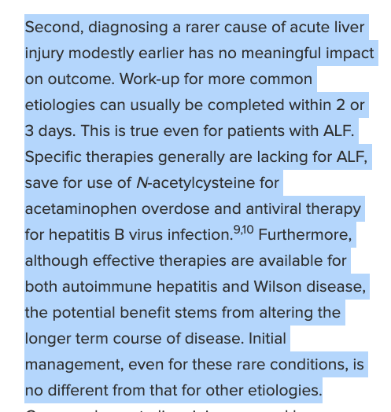
Testing strategy:
AAT deficiency, hemochromatosis, and primary biliary cirrhosis don’t cause Acute Liver Failure
Notes:
Is testing needed? If massive APAP ingestion is reported, no need for testing – per Lancet

Slide 19
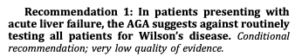
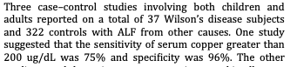
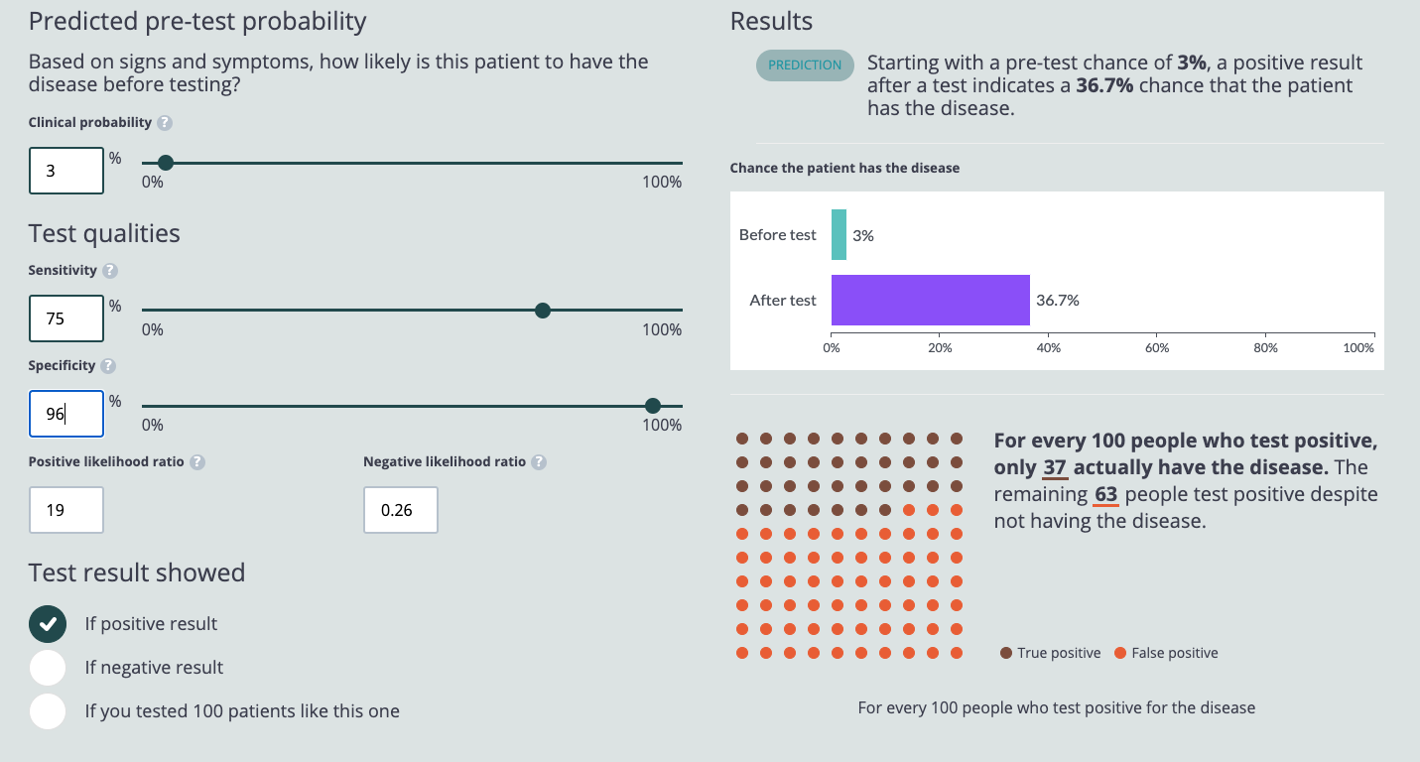

Slide 20
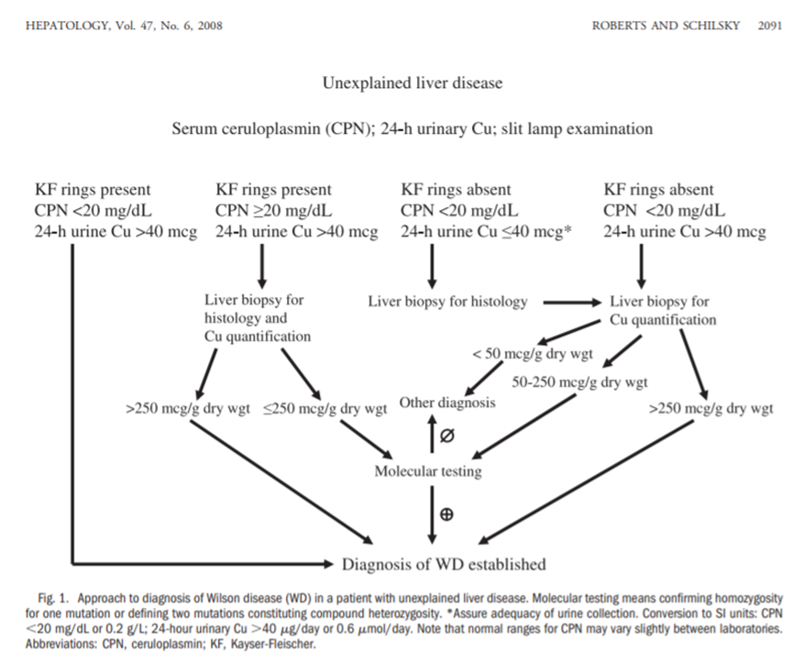
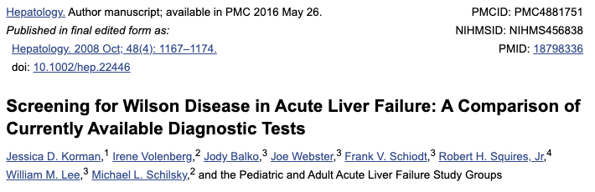
Who should be test for Wilson’s and How?
“High Clinical Suspicion”
3-55 years old (average age at dx is 11)
Kayser-Fleischer rings, AMS
Intravascular Hemolysis (low Hgb)
Alk phos (low. median 20.5), Bilirubin (high, b/c hemolysis. median 44)
Alk phos : Bili ratio << 4:1
AST:ALT ratio also << 2:1 (median 7.5)

Slide 21
Side note: when do patients need a biopsy?
Rarely. Things you might find:
Malignant infiltration (do an MRI or CT first if clinical concern). Would change management
Confirm autoimmune hepatitis – though this will not likely change transplant, and diagnosis can be confirmed on explanted liver.
Confirm hepatitis due to HSV. Test for serology first
Transjugular approach preferred; Bleed risk can be prohibitive

Slide 22
Steroids for alc hep?
Steroids, alcohol hep - European (commonly liver biopsy to confirm all acute) vs American (not biopsied - acute on chronic - this is perhaps why less impressive results.

Slide 23
Case
You pursue a targeted testing strategy.
ASMA, IgG, and ANA are elevated. You are concerned for autoimmune hepatitis causing acute liver failure.
What are the main sources of mortality in these patients?
Notes:
--suggested, but not definitively diagnosed, by the presence of hyperglobulinaemia, antinuclear antibodies, or anti-smoothmuscle antibodies, or any combination of these
A smartphone application for clinicians who treat acute liver failure is now available and includes a diagnostic and daily checklist to remind clinicians to review routine diagnostic and therapeutic measures.54

Slide 24
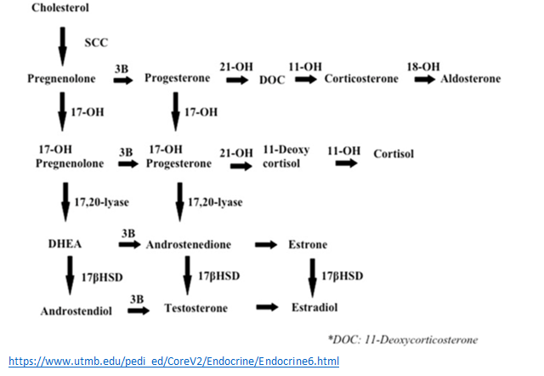
Sources of mortality
Sepsis (but antibiotic ppx has not been shown to help)
Increased Intracranial Pressure
Multi-organ dysfunction syndrome from inflammatory response to DAMPs
Strongly associated with under-production of endogenous steroids
What about bleeding?
Notes:
[x ] 112 Stravitz RT, Ellerbe C, Durkalski V, et al. Bleeding complications in acute liver failure. Hepatology 2018; 67: 1931–42.

Slide 25
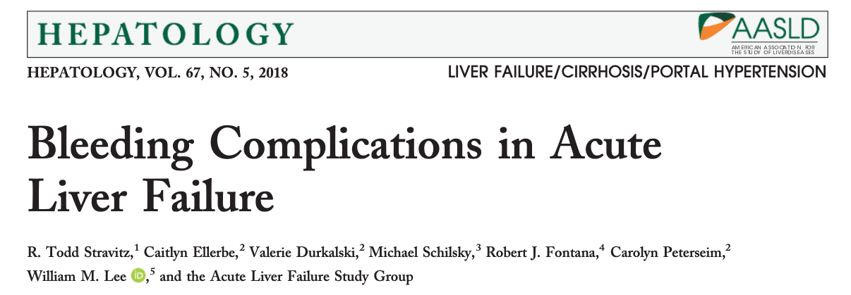
Coagulation
Despite markedly abnormal INR (median 2.7), PTT, platelets - bleeding complications only occur in roughly 10% and are usually not clinically significant
Most commonly UGIB. Most morbidly intracranial bleed (20 of 1770 patients)
Bleeding is NOT associated with higher INR but IS associated with lower PLT
Decreased production of pro-coagulant factors is offset by endothelial injury and inflammation (DAMPS) related hypercoagulant factors.
No role for transfusion of FFP outside of bleeding. If coagulation information would change management, get a TEG

Slide 26
Case
You return to considering your patients, Grade 3 of 4 by WHC. How should this be treated?
Rifaximin
Lactulose
Both
Neither
Protein restriction
Early Enteral Feeding

Slide 27
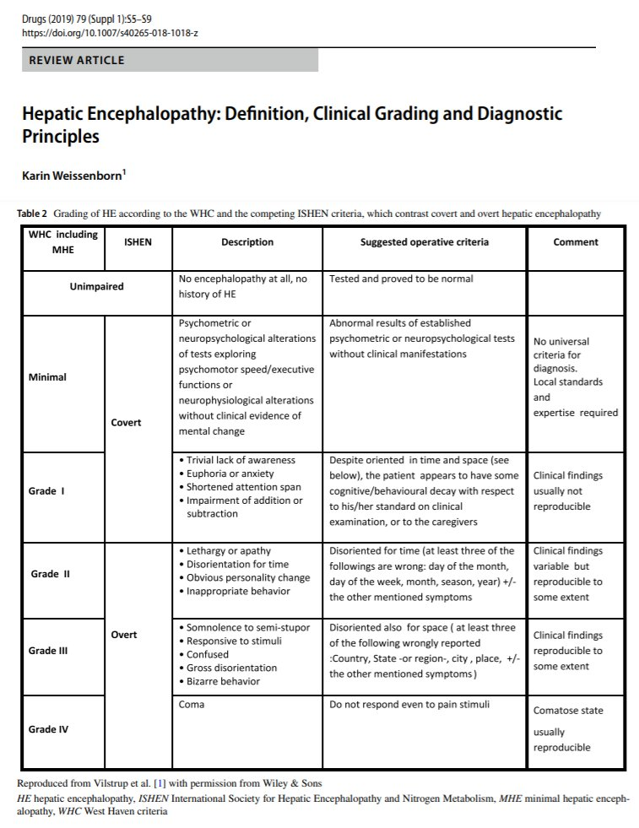
Hepatic Encephalopathy
Type A – Acute Liver Failure
Type B – Portosystemic shunts in the absence of liver failure
Type C – Cirrhosis and porto-systemic bypass
Overwhelmingly the most common, all randomized data from this subtype
Notes:
WHC – West Haven Criteria

Slide 28
Lactulose, Rifaximin, Nutrition …?
Lancet seminar: no data, seems reasonable to use.
AGA: no comment
AASLD 2011: “possibly helpful”
Uptodate: “We do not routinely treat patients with acute liver failure with lactulose. However, if lactulose is used, endotracheal intubation should be performed prior to its administration in patients with advanced (grade III or IV) encephalopathy.” Concern re: gut distention if patient goes to transplant making surgery harder.
No data for rifaximin.
“60 mg protein daily reasonable for most patients with ALF” to reduce catabolism of body stores of protein

Slide 29
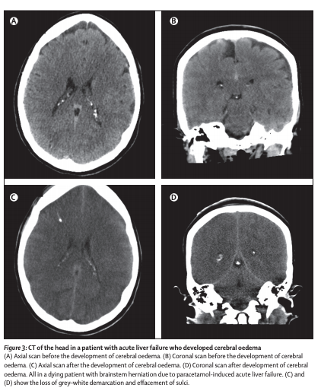
Should you check an ammonia?
Yes!
Not helpful for HE, but is helpful as a marker of risk of ICP
Ammonia over 150 portends high risk of ICP/herniation – consider CRRT. Low transplant free survival (~10%, 33% die pre-during transplant)
Pathogenesis: unclear, but ammonia causally related to astrocyte swelling (unlike the non-causal involvement in HE)
Notes:
Ornithine is an exploratory med for lower levels – not yet studied sufficiently for use though

Slide 30
ICP Assessment
Consider* invasive pressure monitoring
Recommended historically, very high rate of ICP; ICH present in 75% of patients with Grade 4 HE
CT is very insensitive (~25-50%)
Leads to more interventions but no better outcomes
Benefit: no transplant if unlikely neuro intact (poor perfusion pressure)
Or – manage presumptively (next slide)
Factors favoring CRRT when Ammonia 150+:
Hypervolemia (correlates with ICP)
Oliguria
Increasing ammonia
Notes:
The decision to insert a monitor for intracranial pressure is centre-dependent and controversial. Although retrospective studies90–92 have repeatedly shown that patients with intracranial pressure monitors receive more interventions to lower intracranial pressure than do patients without these monitors, none have suggested improvement in outcome and the use of these monitors appears to be declining.
“ In patients with an elevated ICP, the goals of therapy are to reduce the ICP to below 20 to 25 mmHg and to maintain cerebral perfusion pressure above 50 to 60 mmHg”

Slide 31
Although retrospective studies90–92 have repeatedly shown that patients with intracranial pressure monitors receive more interventions to lower intracranial pressure than do patients without these monitors, none have suggested improvement in outcome and the use of these monitors appears to be declining. An intracranial pressure monitor might have value in identifying patients who should not have a transplantation because of prolonged intracranial hypertension or low cerebral perfusion pressure, by predicting poor or no neurological recovery. 93
Notes:
90 Blei AT, Olafsson S, Webster S, Levy R. Complications of intracranial pressure monitoring in fulminant hepatic failure. Lancet 1993; 341: 157–58.
91 Vaquero J, Fontana RJ, Larson AM, et al. Complications and use of intracranial pressure monitoring in patients with acute liver failure and severe encephalopathy. Liver Transpl 2005; 11: 1581–89.
92 Karvellas CJ, Fix OK, Battenhouse H, Durkalski V, Sanders C, Lee WM. Outcomes and complications of intracranial pressure monitoring in acute liver failure: a retrospective cohort study. Crit Care Med 2014; 42: 1157–67
93 Lidofsky SD, Bass NM, Prager MC, et al. Intracranial pressure monitoring and liver transplantation for fulminant hepatic failure. Hepatology 1992; 16: 1–7

Slide 32
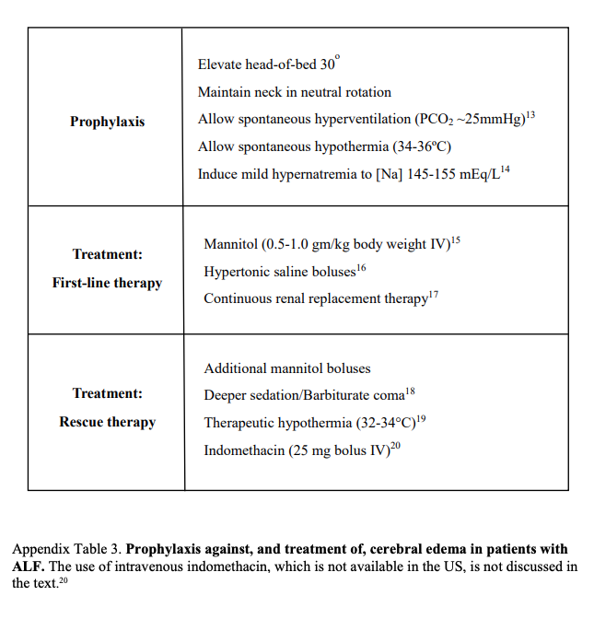
ICP Management
Hyponatremia: water moves into astrocytes. Hypernatremia pulls it out
RCT: Na 145-155 lowers ICP compared to 137-142.
Effect of (mechanical) hyperventilation on ICP is transient
They already hyperventilate because of HE

Slide 33
Hypotension due to low SVR
Fluids, Pressors, then Recommend trial of steroids if refractory
HepatoADrenal syndrome
Liver synthesizes cholesterol
Cholesterol is base structure for synthesis of endogenous steroids
*** Elliot Trapper Tweetorial hepato-adrenal syndrome
https://twitter.com/ebtapper/status/1278427501300273152
More chronic cirrhosis…

Slide 34
Case
You check an ammonia. It’s 175. She’s hypervolemic, so you plan to dialyze. You correctly ignore the INR, do not give FFP, and just put in the dialysis catheter. You put in an enteral feeding tube and start feeds. You leave it to the intern to decide about lactulose and rifaximin.
Can this patient’s liver failure be treated without transplant?

Slide 35
ALF Treatment – the forest-level view
2 treatments has good evidence of improving transplant free survival.
NAC for APAP. Discussed in recent lecture
Prompt delivery if related to pregnancy (acute fatty liver, HELLP)
Treatments that may help:
Anti-retrovirals for HBV - nucleos(t)ide hepatitis B virus DNA polymerase inhibitors to reduce the risk of recurrence after liver transplantation. No benefit in transplant free survival
Prednisone +/- Azathioprine for Autoimmune Hepatitis usually does not have an immediate effect sufficient to avoid transplant (effect is long term)
Penicillin (and charcoal if early) in Amanita phalloides ingestion
Acyclovir is recommended but not well studied if related to HSV
PLEX to remove copper for Wilson’s disease. Does not usually have an effect fast enough to avoid transplant. Chelation doesn’t work
Notes:
“
“Furthermore, although effective therapies are available for both autoimmune hepatitis and Wilson disease, the potential benefit stems from altering the longer term course of disease.”
“
“Even in acute liver failure caused by autoimmune hepatitis, corticosteroids have not been convincingly shown to improve outcome.63 A trial of corticosteroids should be administered to patients with low-grade (grade 1 or 2) hepatic encephalopathy due to autoimmune hepatitis, and only for a finite period of time (around 1 week) to avoid increasing the risk of peritransplantation infection.64”

Slide 36
NAC in non-APAP ALF?
Argument of uncertainty – has APAP truly been excluded?
Obs data and a Double blind RCT n=173 of NAC vs Placebo.
Primary endpoint mortality: no benefit
Secondary endpoint transplant-free survival: 40% (NAC) vs 27% (placebo)
Well tolerated
Notes:
[ ] 69 Darweesh SK, Ibrahim MF, El-Tahawy MA. Effect of N-acetylcysteine on mortality and liver transplantation rate in non-acetaminophen-induced acute liver failure: a multicenter study. Clin Drug Investig 2017; 37: 473–82.
[ ] Nabi T, Nabi S, Rafiq N, Shah A. Role of N-acetylcysteine treatment in non-acetaminophen-induced acute liver failure: a prospective study. Saudi J Gastroenterol 2017; 23: 169–75.
[ ] 71 Mumtaz K, Azam Z, Hamid S, et al. Role of N-acetylcysteine in adults with non-acetaminophen-induced acute liver failure in a center without the facility of liver transplantation. Hepatol Int 2009; 3: 563–70.
[ x] 72 Lee WM, Hynan LS, Rossaro L, et al. Intravenous N-acetylcysteine improves transplant-free survival in early stage non-acetaminophen acute liver failure. Gastroenterology 2009; 137: 856–64.

Slide 37
Prognostication - labs
After single acute hit: AST/ALT peak quick, then INR, then Bilirubin
Decreasing AST/ALT could be improvement, or decreased hepatocyte mass
In this case if bili and INR continue to increase for more than a day or two, argues toward the later
In APAP overdose - dropping phosphate level actually has good prognostic significance
Signifies phos moving into cells - possibly due to metabolic demands due to regenerating liver
Notes:
[ ] 118 Koch DG, Tillman H, Durkalski V, Lee WM, Reuben A. Development of a model to predict transplant-free survival of patients with acute liver failure. Clin Gastroenterol Hepatol 2016; 14: 1199–206.

Slide 38
Etiology matters greatly

Slide 39
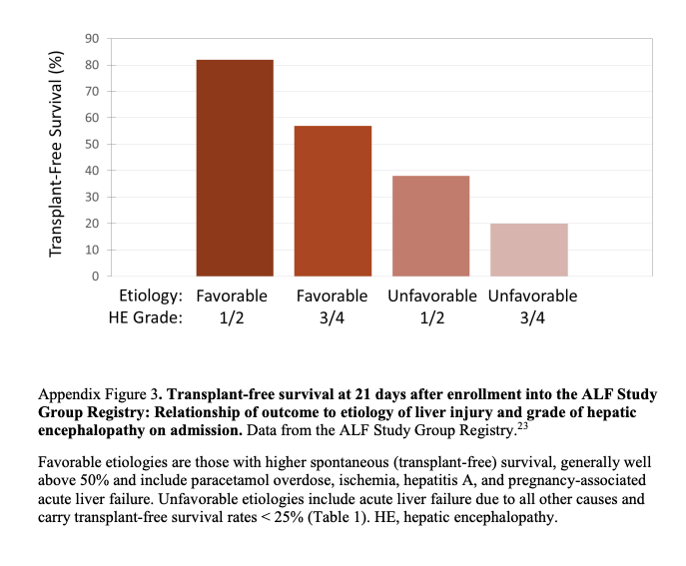
Etiology matters greatly
Notes:
Bad HE but better etiology = better than less HE but bad etiology

Slide 40
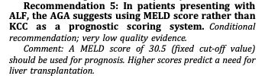
Scores
King’s College Criteria (1989): inaccurate in modern liver failure, especially when not induced by acetaminophen. Poor negative predictive value (many die without positive score)
MELD, though derived for cirrhosis, has some predictive value.
MELD 30.5 is cutoff for needing transplant
Not used for listing status: ALF – Listed status 1 (“super-urgent”) due to high non-transplant mortality in 7d. 21d operative mortality rate is higher than cirrhosis, but then stabilizes.
Notes:
[ ] mortality on the liver transplant list

Slide 41
Transplant for alcoholic hepatitis?
1983 NIH consensus conference on Liver Transplant: consider only in patient judged likely to abstain, “only a small portion of patients expected to meet this criteria” => 6 month criteria
Increasing recognition that abstinence prediction inaccurate, relapse doesn’t cause graft failure often, AUD similar to other behavioral d/o
2011 Prospective study in France/Belgium: no prior decompensation, supportive family, commitment to abstinence –
Survival 77% in transplanted group, 23% in non-transplanted matched pts
15% relapse rate for alcohol use (10% harmful)
Immediately std of care in Europe, adoption in US slower

Slide 42

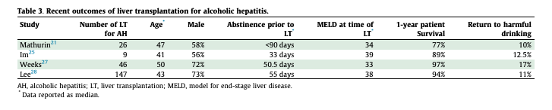
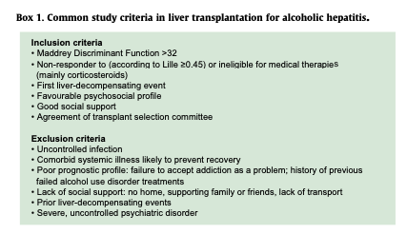
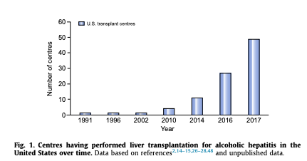

Slide 43
Takeaways – Acute Liver Failure
AST/ALT 10x ULN, INR over 1.5, and HE => ALF, much worse prognosis than no HE
Test for common causes first. Only test for Wilson’s if low AP:Bili ratio, high AST:ALT ratio and right demographic. Do not test for NASH, HCV, A1AT, PBC (anti-mito), Hemochrom.
Do not treat INR as a coagulation test in ALF.
Check ammonia – if over 150, consider CRRT and transplant listing.
Manage ICP aggressively in grade 3 and 4 HE
AST/ALT decreasing, Bili and INR continue to increase = badness
Notes:
“Prophylactic administration of fresh frozen plasma is not recommended since it has not been shown to influence mortality in a small randomized trial [11], can interfere with assessments of liver function, and may lead to fluid overload [12].”
Up to date

